Slide 1

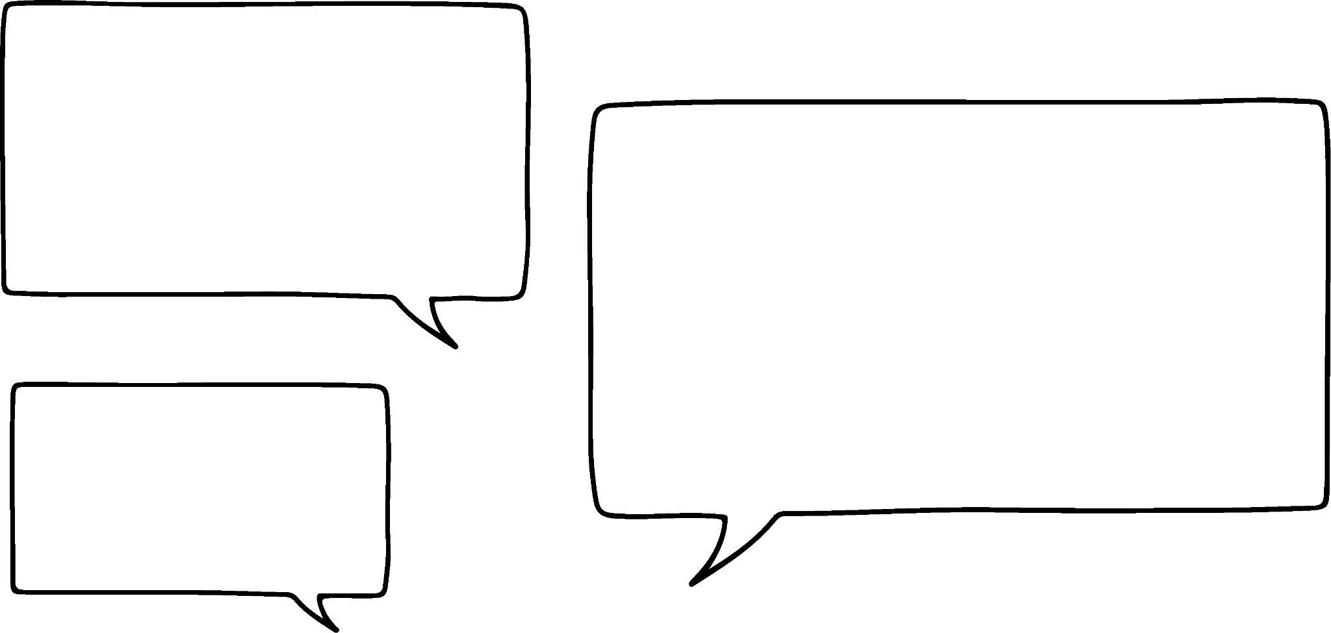
Additive relationships
Task A: Rearranging additive relationships
1) Write the family of rearrangements for the below equations. Draw a bar model to support if needed.
a)
b)
58 + 76 = 134
134 − 76 = 58
11 + h = 19
19 − h = 11
76 + 58 = 134
134 − 58 = 76
h + 11 = 19
19 − 11 = h
1.9
11
h
58
76
5.36
19
134
c)
d)
x + 3 = y
y − 3 = x
5y² + 2x = 100
100 − 2x = 5y²
3 + x = y
y − x = 3
2x + 5y² = 100
100 − 5y² = 2x
3
x
5y²
2x
y
100
2) Lucas is rearranging equations.
I see a lot of it as ‘swapping positions’ in the equation.
In each case decide if Lucas is correct and write a sentence to justify your decision.
a)
If 3v + 5w = 52 then
5w + 3v = 52 is also true.
3v + 5w = 52
5w + 3v = 52
True. This is an example of the commutativity of addition.
b)
If 73 − 8x = 49 then
73 − 49 = 8x is also true.
73 − 8x = 49
73 − 49 = 8x
True. 8x and 49 can swap positions because we can think of 73 as the sum.
c)
If 3x − 2 = 8y then
8y − 2 = 3x is also true.
3x − 2 = 8y
8y − 2 = 3x
Not true. 3x and 8y can not swap positions.
3x is the sum so only the 2 and 8y can swap positions.

Slide 2



Additive relationships
Task B: The sum of multiple terms as a term
1) Fill in the blanks in these rearrangements:
a)
j + k + 8 = 13
b)
j + k + 8 = 13
j = 13 − (k + 8)
k = 13 − (j + 8)
c)
7x + 8y + 9z = 10
d)
7x + 8y + 9z = 10
7x = 10 − (8y + 9z)
9z = 10 − (7x + 8y)
e)
3x² + 7y³ − 4 = 10
f)
3x² − 7y³ + 4 = 10
3x² = 10 − (7y³ − 4)
3x² = 10 − (4 − 7y³)
2) Alex has done really well in this lesson but has made a few errors. Mark his work on rearranging and write a sentence to explain any errors you spot.
a)
x + 3y + z = 7
b)
9x³ − y² + 1 = 8
x = 7 − (3y + z)
9x³ = 8 − (y² + 1)
−y² and 1 need to be grouped before subtracting.
9x³ = 8 − (1 − y²)
c)
x + 3y + 5 = 7
d)
5d + 2e³ − 4 = 10
x = 7 − (3y + 5)
5d = 10 − (2e³ − 4)
x = 7 − 3y + 5
We need to subtract both terms inside the brackets.
5d = 10 − 2e³ + 4
x = 12 − 3y
5d = 14 − 2e³
x = 7 − (3y + 5)
x = 7 − 3y − 5
x = 2 − 3y
Mathematics in Education and Industry
v2.3

